Slide 1
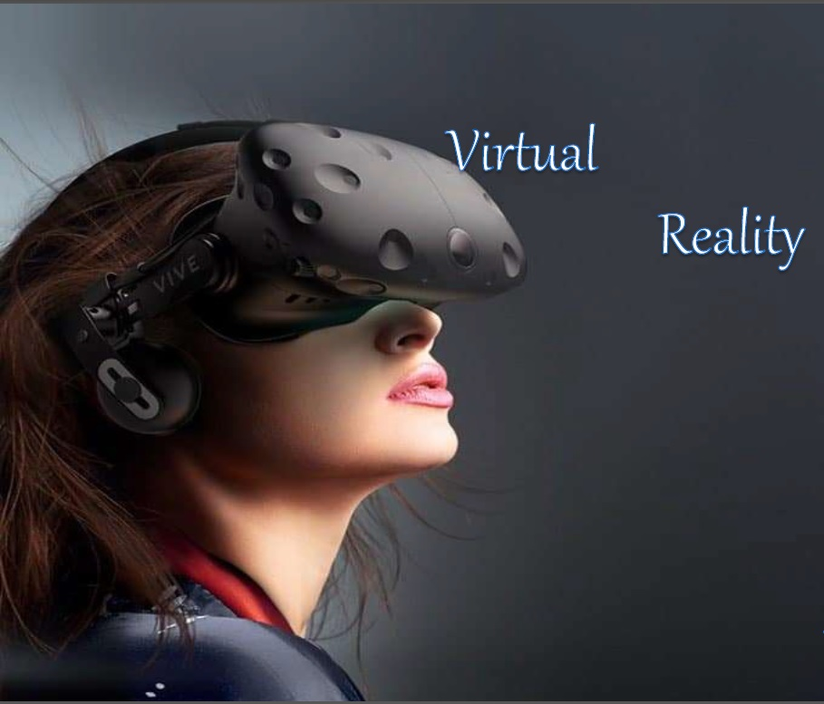
Virtual & Augmented Reality

Slide 2
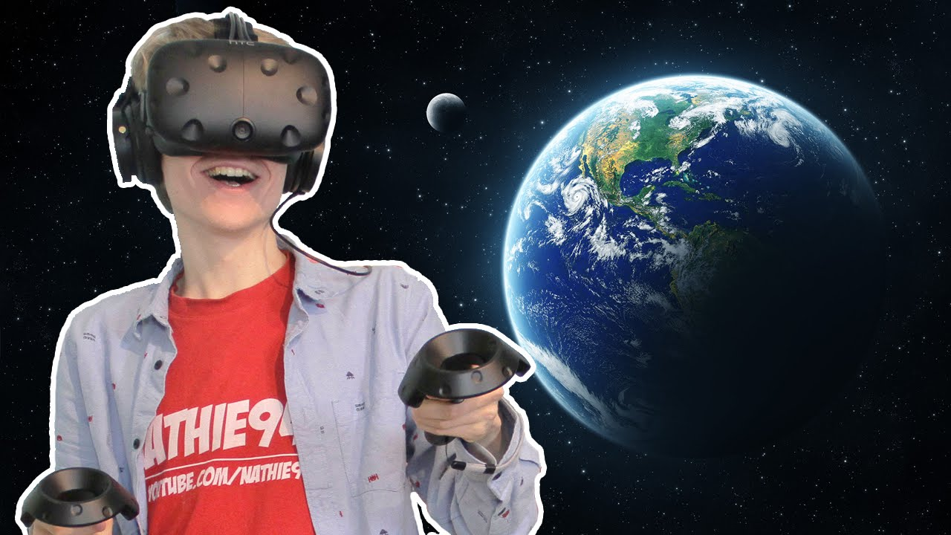
What is VR?
VR Experience:
https://www.youtube.com/watch?v=qYfNzhLXYGc
Virtual Reality (VR) means feeling the imaginary(virtual) world as real that is a simulation running in a computer. Virtual reality is the term used for computer generated 3D environments that allow the user to enter and interact with alternate realities.
The definition of ‘virtual’ is near and ‘reality’ is what we experience as human beings.
Virtual Reality refers to a high-end user interface that involves real-time simulation and interactions through multiple sensorial channels.
VR Tool:
https://www.youtube.com/watch?v=jnqFdSa5p7w

Slide 3
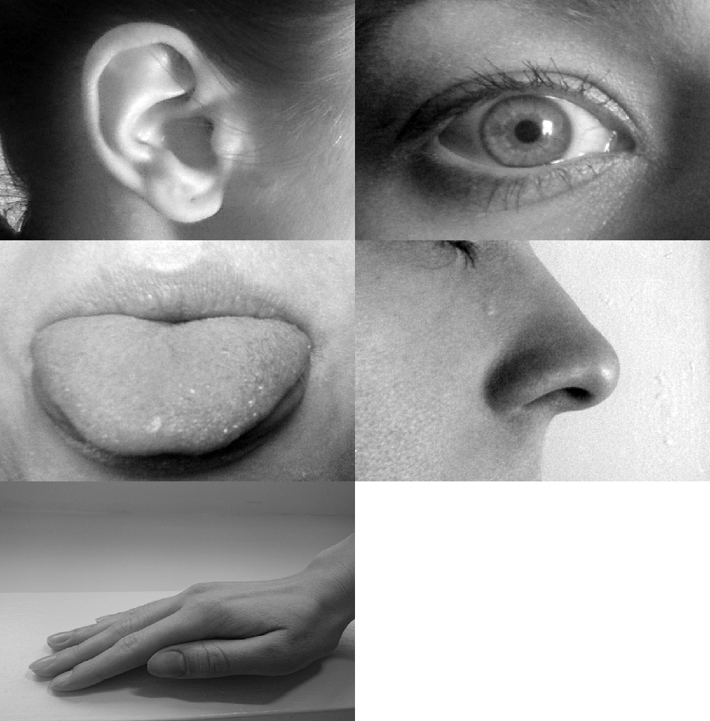
How do we perceive reality?
We understand the world through
our senses:
• Sight, Hearing, Touch, Taste, Smell
(and others..)
Two basic processes:
• Sensation – Gathering information
• Perception – Interpreting information
Sight/visualising
Hearing
Taste
Smell
Sense/Touch

Slide 4
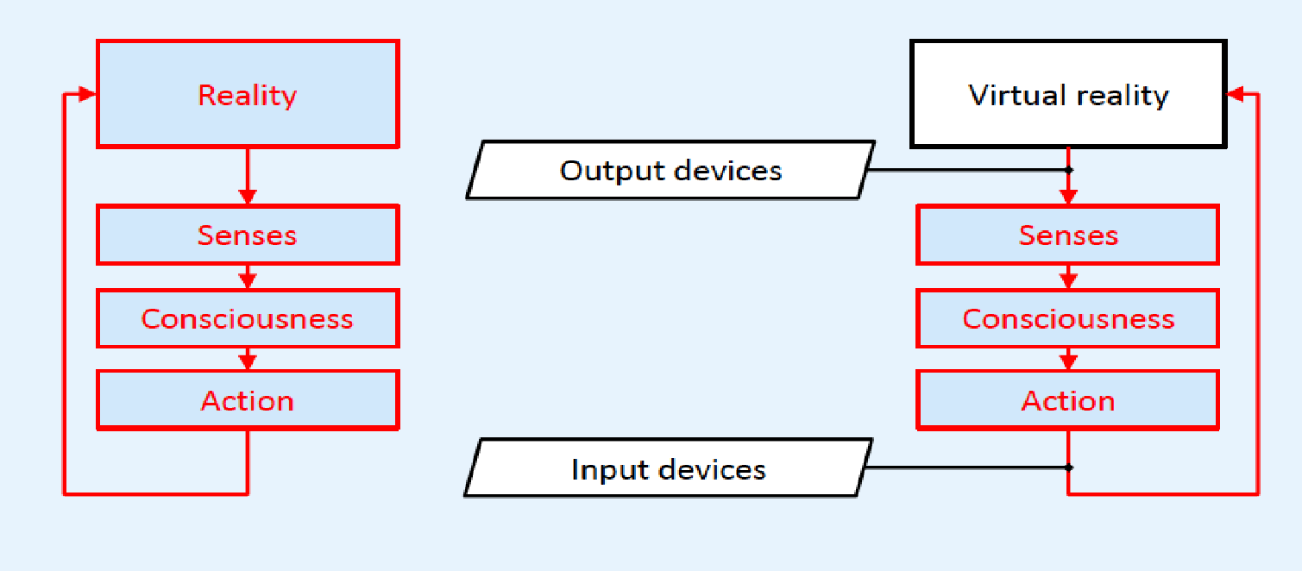
Reality vs. virtual reality
In a VR system, there are input and output devices between human perception and action

Slide 5
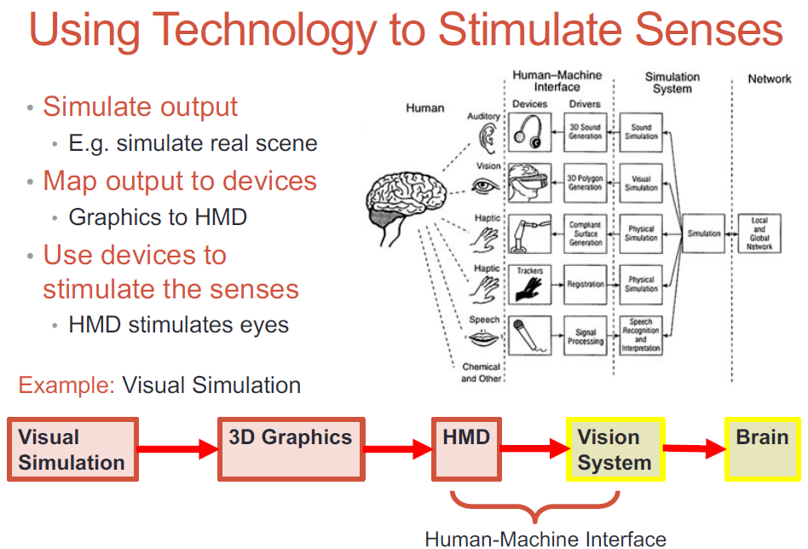
Use of technologies to simulate senses
Creating an Immersive Experience:
Head Mounted Display
Immerse the eyes
Projection/Large Screen
Immerse the head/body
Future Technologies:
Neural implants
Contact lens displays, etc

Slide 6
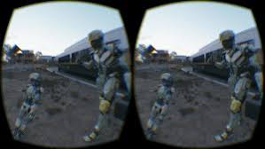
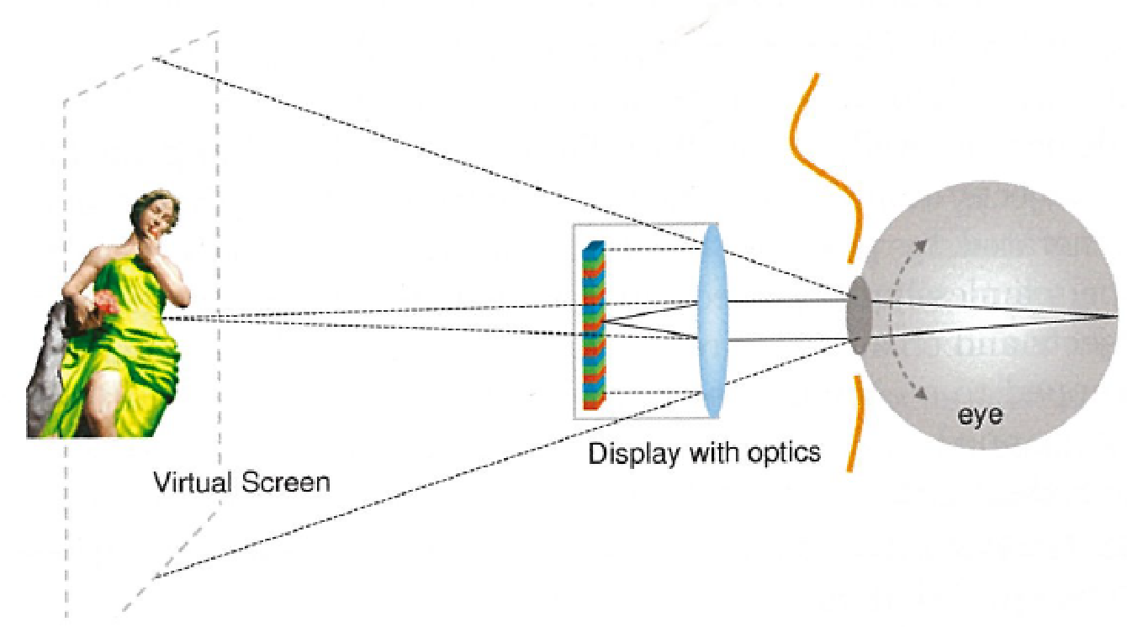
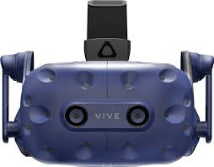
HMD Display Principles
VR Stereo images
Principle of Stereo image generation and illusion on brain
VR Stereo images
Left-eye image
Right-eye image
Fig. Principle of display with optics to create illusion of virtual screen

Slide 7
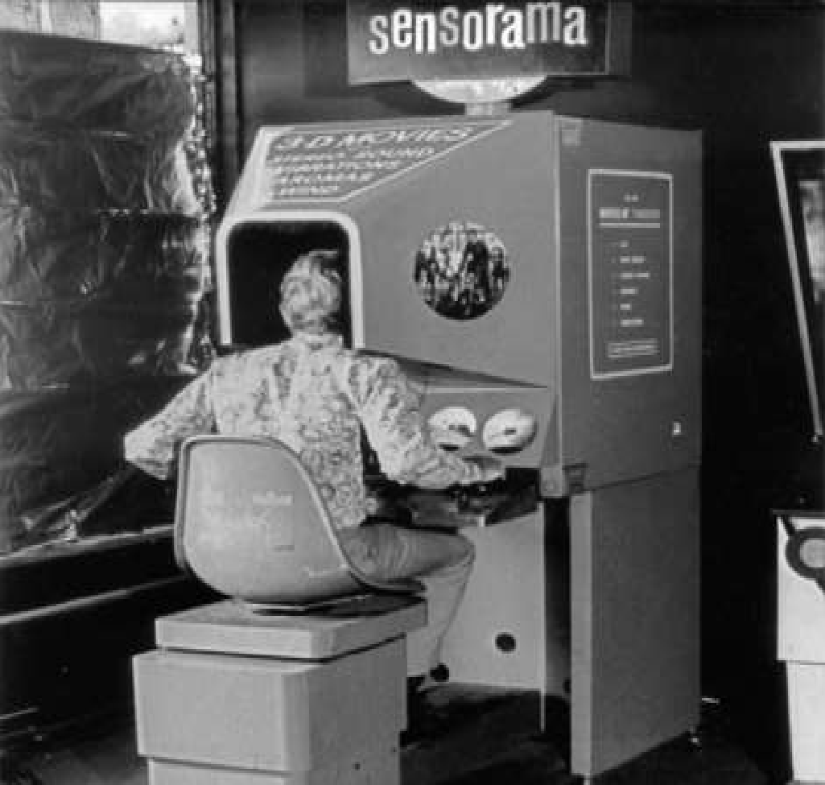
History of virtual reality
In mid 1950s, a visionary cinematographer, Morton Heilig developed the Sensorama (patented 1962) which was an arcade-style theatre cabinet that would stimulate all the senses, not just sight and sound.
It featured stereo speakers, a stereoscopic 3D display, fans, smell generators and a vibrating chair. The Sensorama was intended to fully immerse the individual in the film.
He also created six short films for his invention all of which he shot, produced and edited himself.
The Sensorama films were titled, Motorcycle, Belly Dancer, Dune Buggy, helicopter, A date with Sabina and I’m a coca cola bottle!.

Slide 8
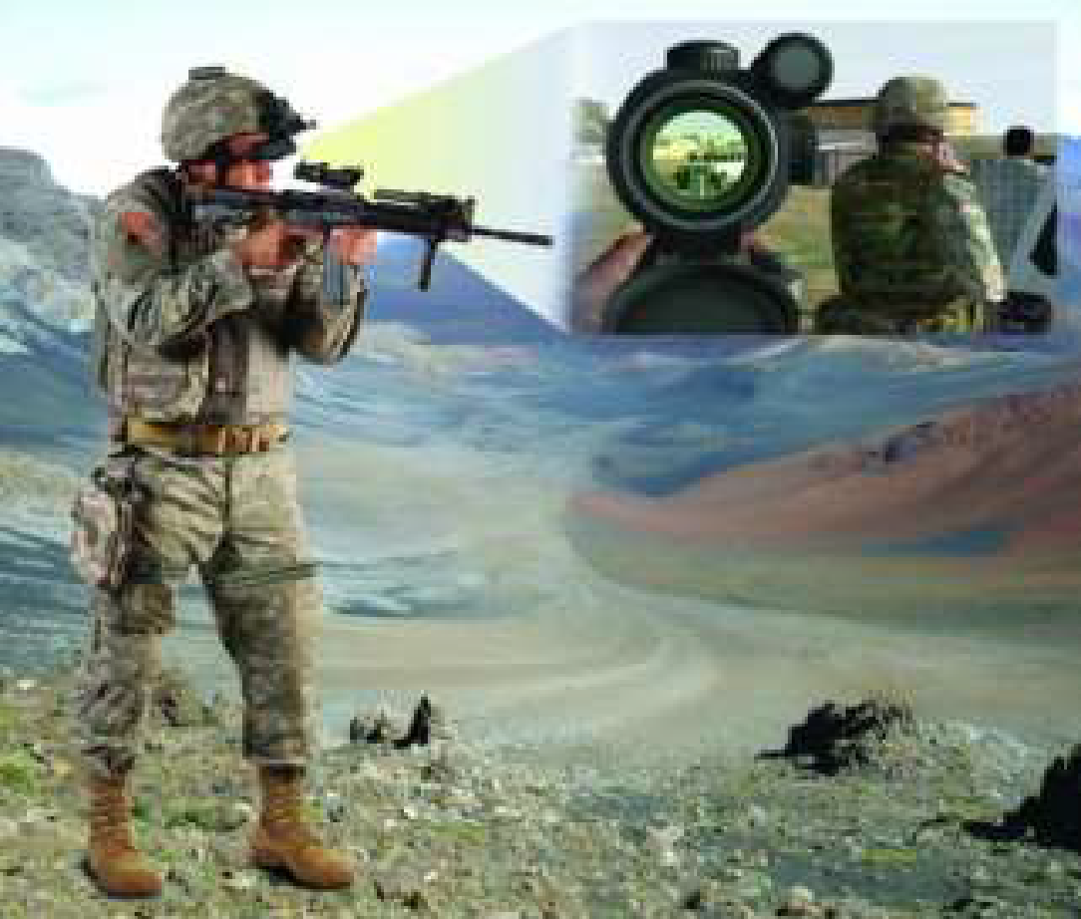
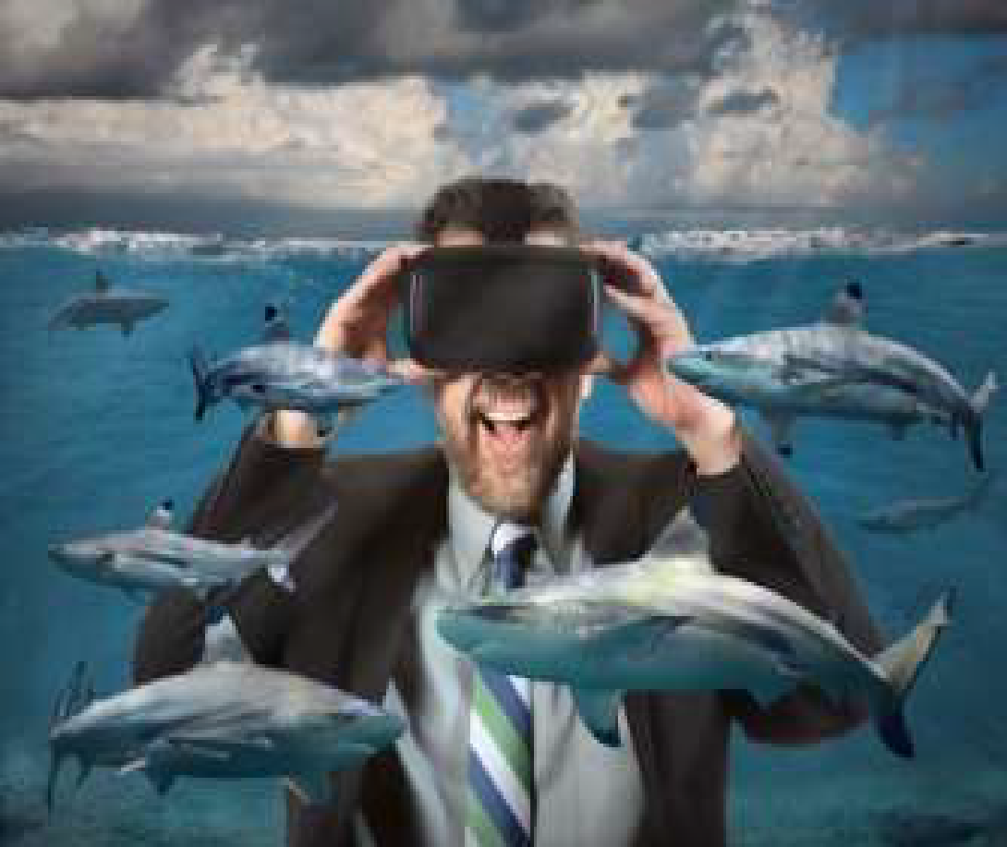
Types of virtual reality
Immersive Virtual Reality
Non-immersive Virtual Reality
Window on world Virtual Reality
Immersive Virtual Reality:
Immersion into virtual reality is a perception of being physically present in a non-physical world.
Elements of virtual environments that increase the immersiveness of the experience:
Continuity of surroundings
Conformance to human vision
Freedom of movement
Physical interaction
Physical feedback

Slide 9
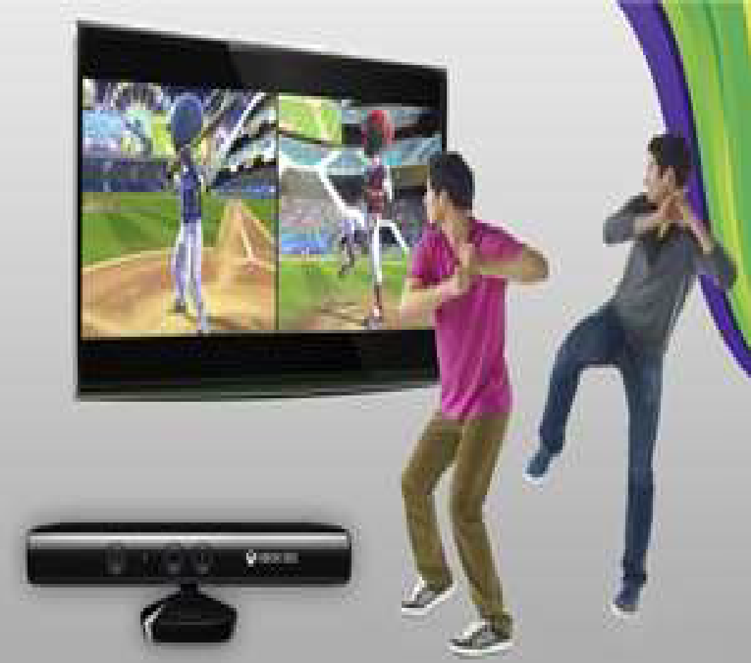
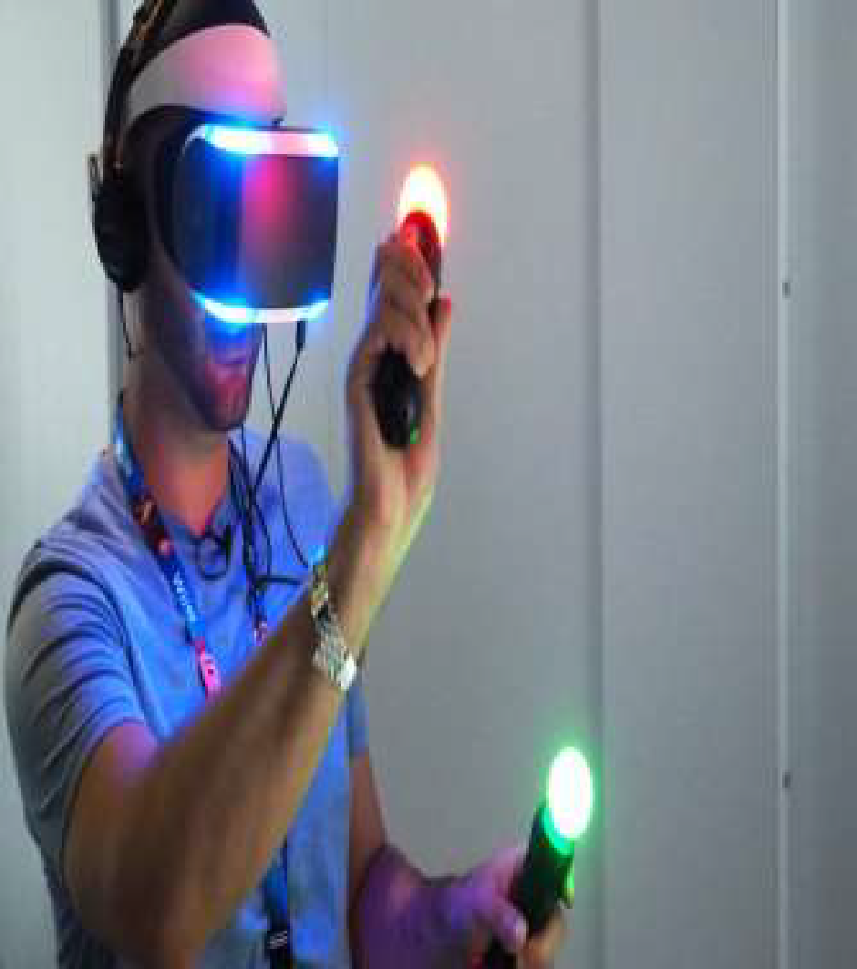
Types of virtual reality (cont.)
Non-Immersive Virtual Reality:
Large display, but doesn’t surround the user.

Slide 10
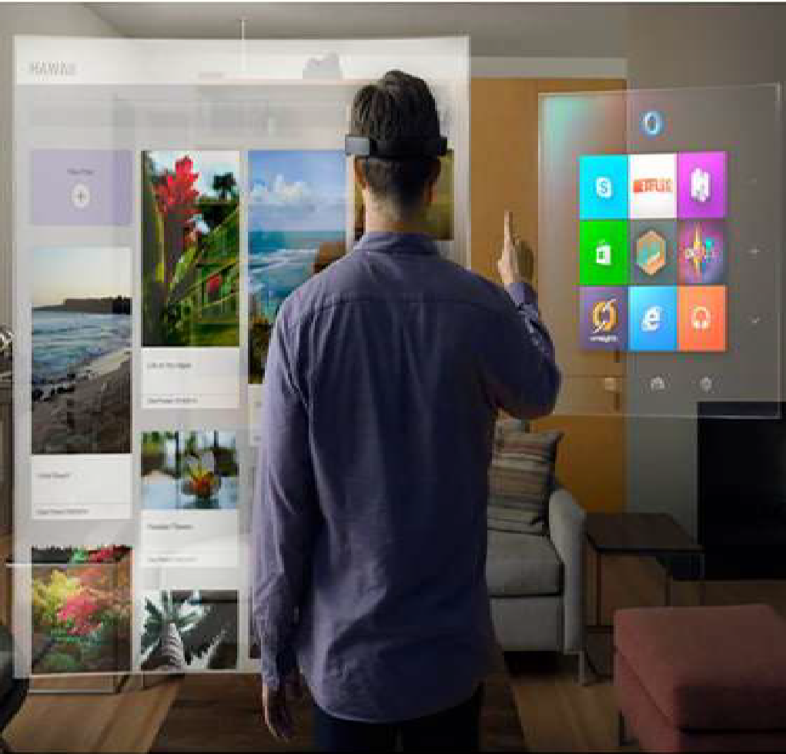
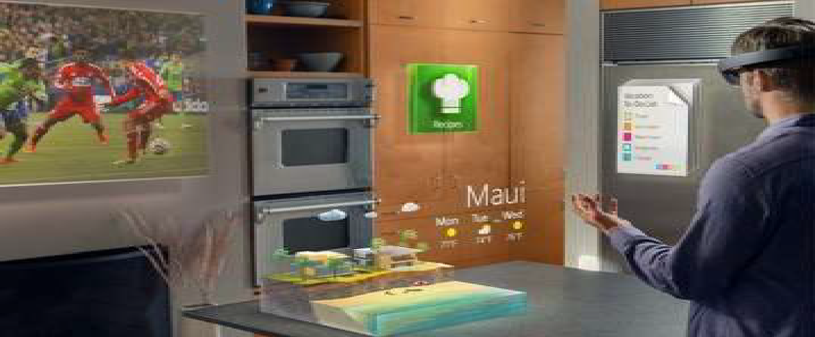
Types of virtual reality (cont.)
Window on world Virtual Reality:
Desktop- based Virtual Reality involves displaying a 3-dimensional virtual on regular desktop display without use of any specialized movement tracking environment.

Slide 11
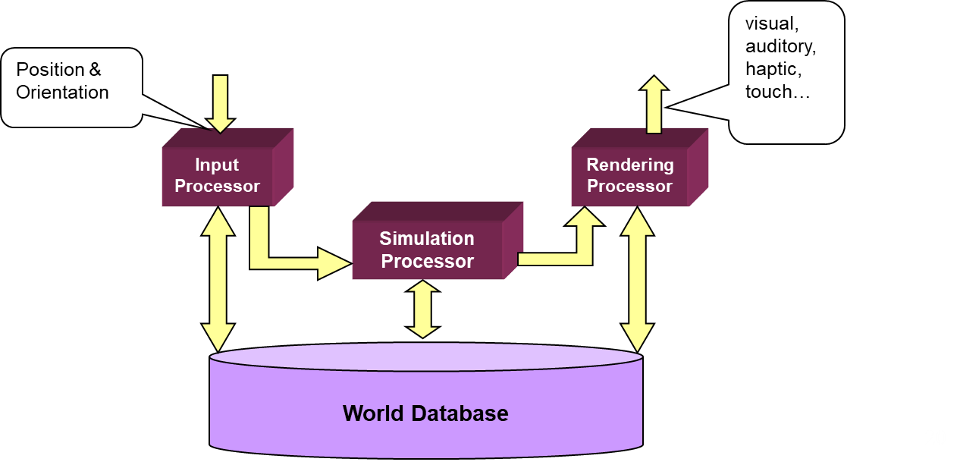
Architecture of a VR System
Components of a VR System:
Input Processor
Simulation Processor
Rendering Processor
World Database
Fig. Architecture of a VR System

Slide 12
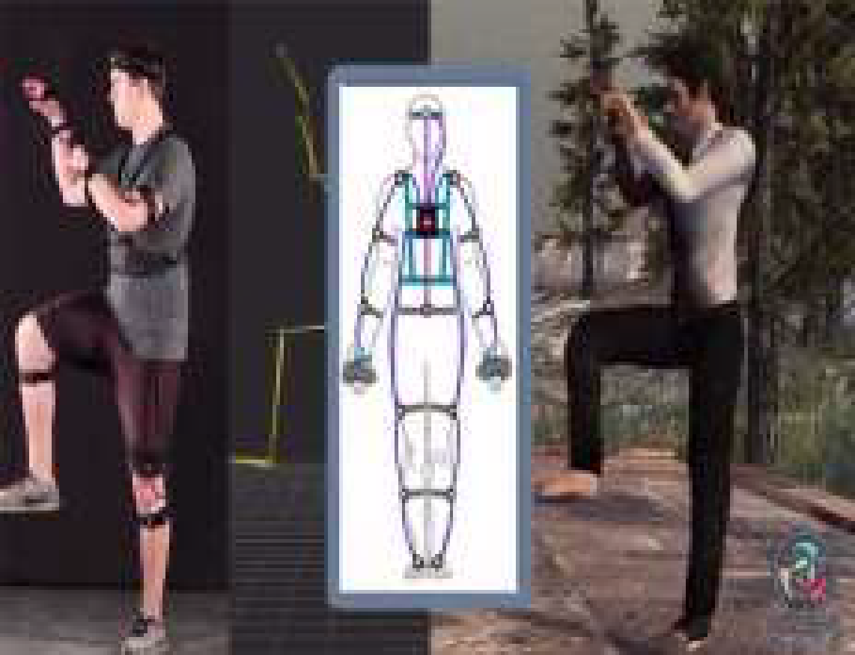
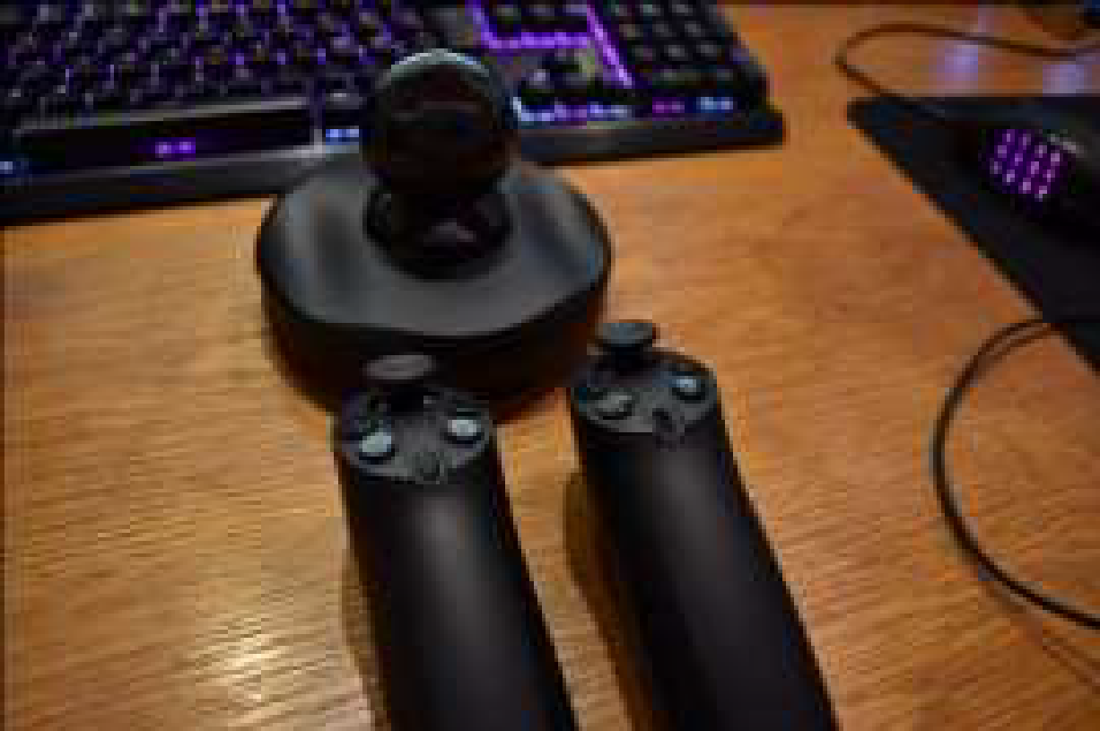

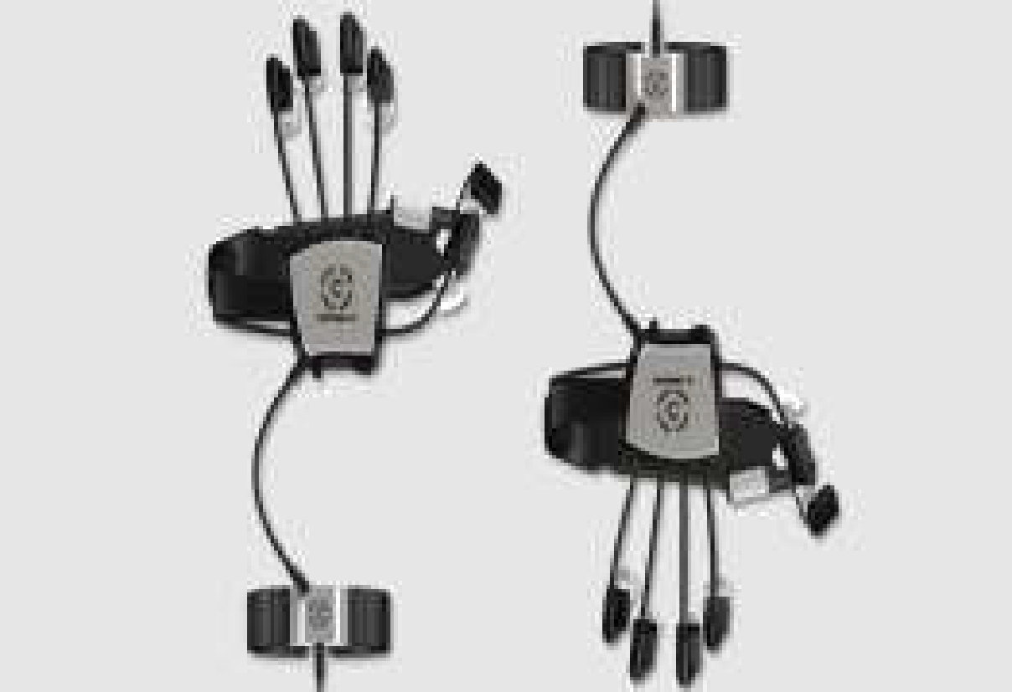
Components of VR System
Input Processor:
Control the devices used to input information to the computer.
The object is to get the coordinate data to the rest of the system with minimal lag time.
Keyboard, mouse, 3D position trackers, a voice recognition system, etc.
Input Devices
Prio VR
Razer Hydra
Stem
Control VR

Slide 13
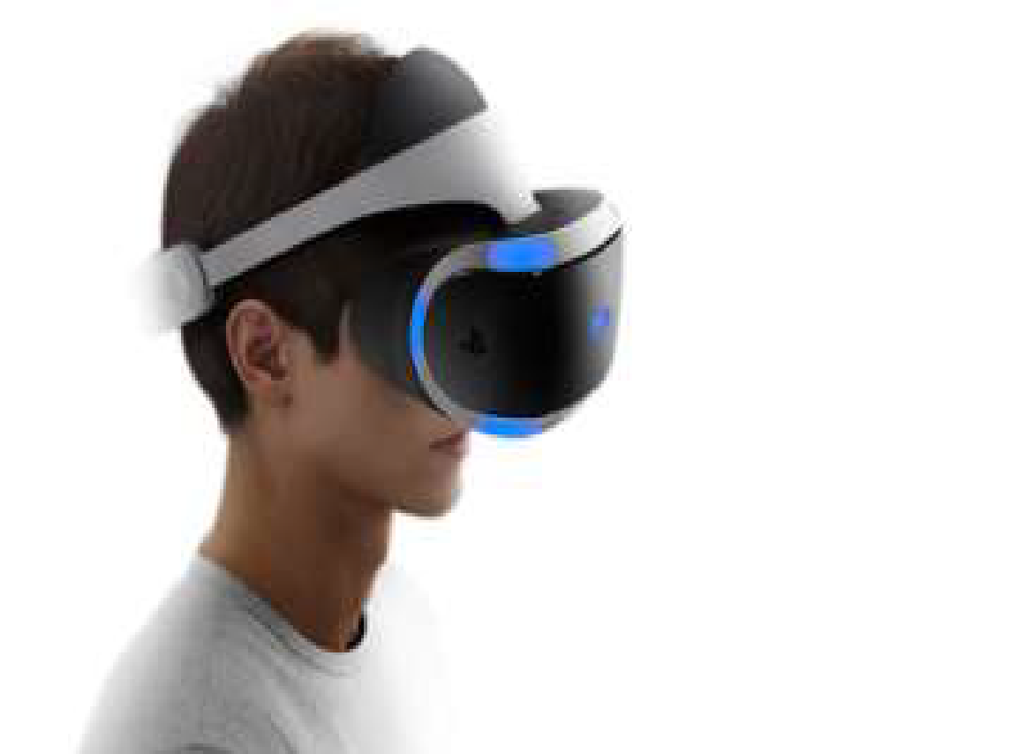
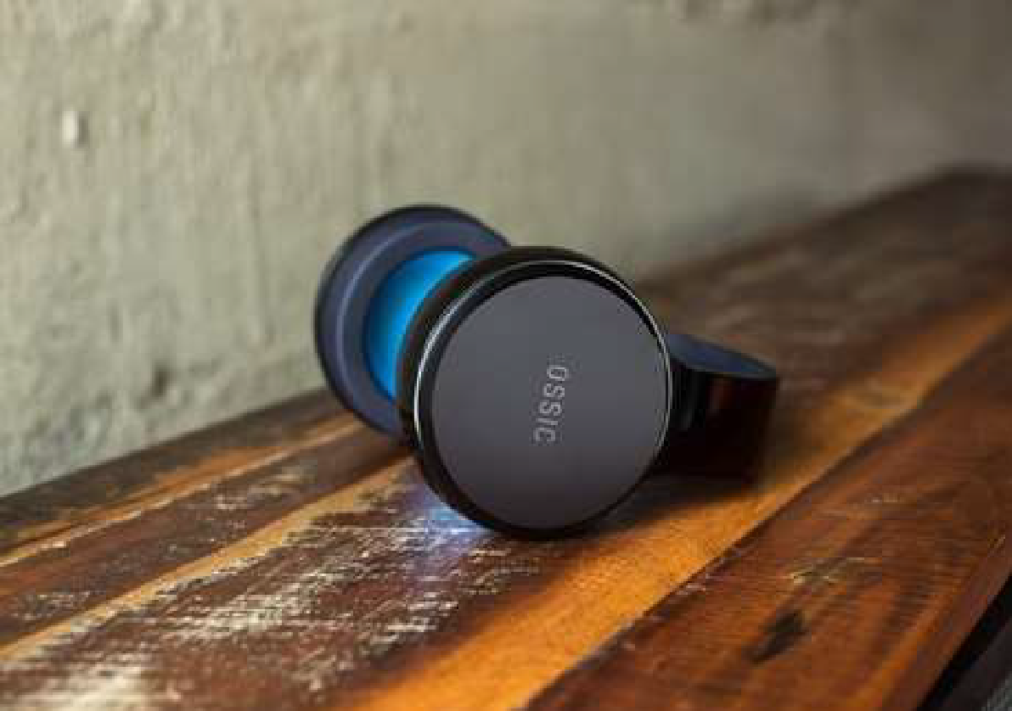
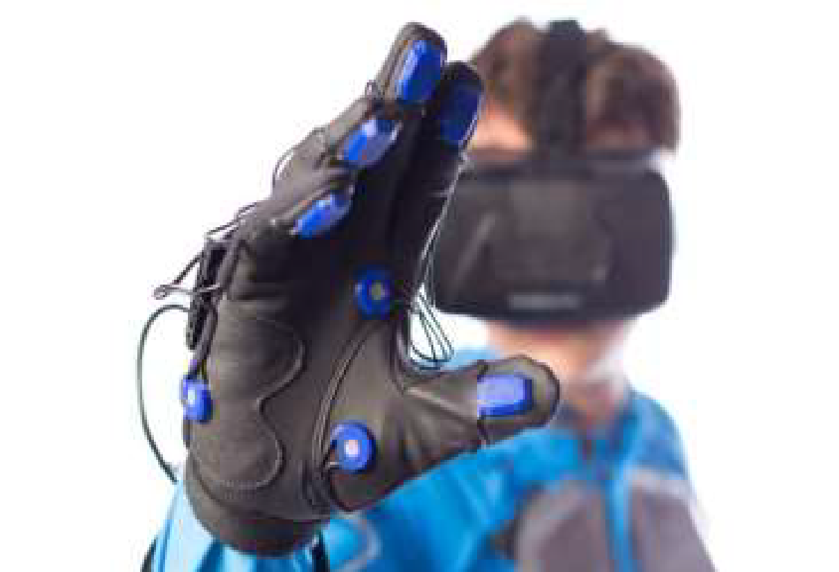
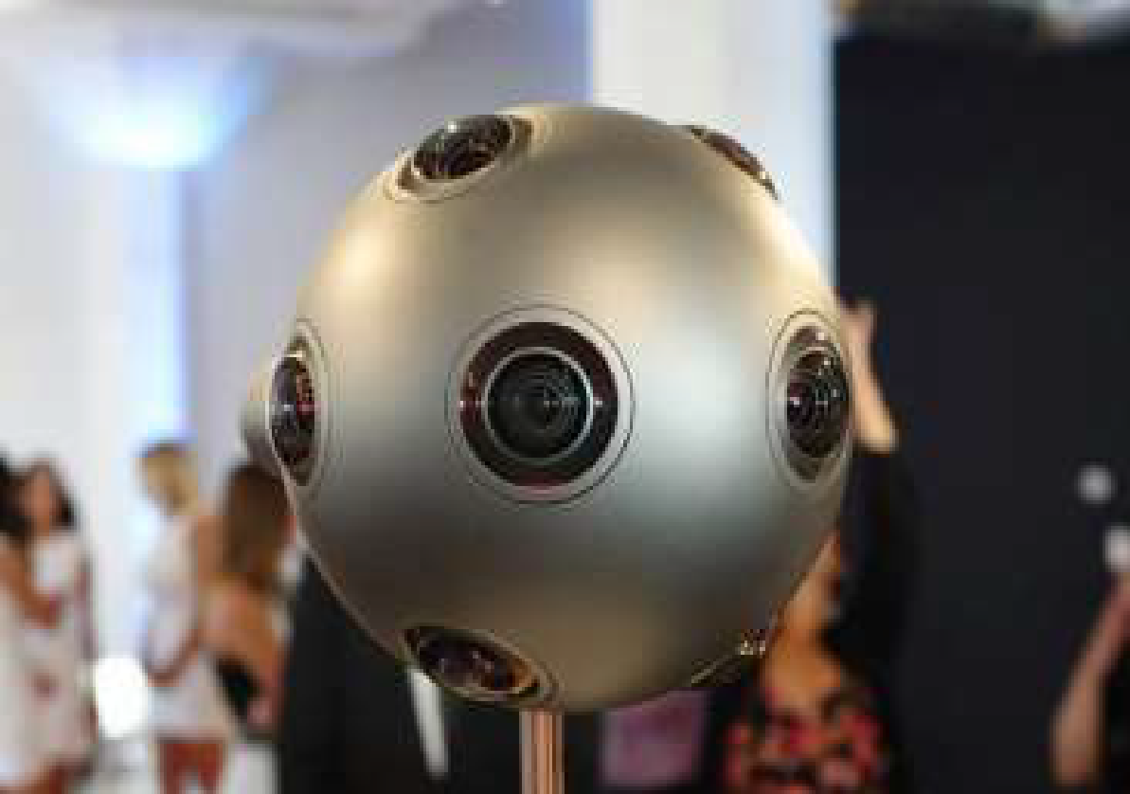
Components of VR System (cont.)
Output devices
Simulation Processor :
Core of a VR system.
Takes the user inputs along with any tasks programmed into the world and determine the actions that will take place in the virtual world.
3D Audio
VR headset
Helsinki
Sensing Gloves

Slide 14
Virtual & Augmented Reality

Slide 15
What is VR?
VR Experience:
https://www.youtube.com/watch?v=qYfNzhLXYGc
Virtual Reality (VR) means feeling the imaginary(virtual) world as real that is a simulation running in a computer. Virtual reality is the term used for computer generated 3D environments that allow the user to enter and interact with alternate realities.
The definition of ‘virtual’ is near and ‘reality’ is what we experience as human beings.
Virtual Reality refers to a high-end user interface that involves real-time simulation and interactions through multiple sensorial channels.
VR Tool:
https://www.youtube.com/watch?v=jnqFdSa5p7w

Slide 16
How do we perceive reality?
We understand the world through
our senses:
• Sight, Hearing, Touch, Taste, Smell
(and others..)
Two basic processes:
• Sensation – Gathering information
• Perception – Interpreting information
Sight/visualising
Hearing
Taste
Smell
Sense/Touch

Slide 17
Reality vs. virtual reality
In a VR system, there are input and output devices between human perception and action

Slide 18
Use of technologies to simulate senses
Creating an Immersive Experience:
Head Mounted Display
Immerse the eyes
Projection/Large Screen
Immerse the head/body
Future Technologies:
Neural implants
Contact lens displays, etc

Slide 19
HMD Display Principles
VR Stereo images
Principle of Stereo image generation and illusion on brain
VR Stereo images
Left-eye image
Right-eye image
Fig. Principle of display with optics to create illusion of virtual screen

Slide 20
History of virtual reality
In mid 1950s, a visionary cinematographer, Morton Heilig developed the Sensorama (patented 1962) which was an arcade-style theatre cabinet that would stimulate all the senses, not just sight and sound.
It featured stereo speakers, a stereoscopic 3D display, fans, smell generators and a vibrating chair. The Sensorama was intended to fully immerse the individual in the film.
He also created six short films for his invention all of which he shot, produced and edited himself.
The Sensorama films were titled, Motorcycle, Belly Dancer, Dune Buggy, helicopter, A date with Sabina and I’m a coca cola bottle!.

Slide 21
Types of virtual reality
Immersive Virtual Reality
Non-immersive Virtual Reality
Window on world Virtual Reality
Immersive Virtual Reality:
Immersion into virtual reality is a perception of being physically present in a non-physical world.
Elements of virtual environments that increase the immersiveness of the experience:
Continuity of surroundings
Conformance to human vision
Freedom of movement
Physical interaction
Physical feedback

Slide 22
Types of virtual reality (cont.)
Non-Immersive Virtual Reality:
Large display, but doesn’t surround the user.

Slide 23
Types of virtual reality (cont.)
Window on world Virtual Reality:
Desktop- based Virtual Reality involves displaying a 3-dimensional virtual on regular desktop display without use of any specialized movement tracking environment.

Slide 24
Architecture of a VR System
Components of a VR System:
Input Processor
Simulation Processor
Rendering Processor
World Database
Fig. Architecture of a VR System

Slide 25
Components of VR System
Input Processor:
Control the devices used to input information to the computer.
The object is to get the coordinate data to the rest of the system with minimal lag time.
Keyboard, mouse, 3D position trackers, a voice recognition system, etc.
Input Devices
Prio VR
Razer Hydra
Stem
Control VR

Slide 26
Components of VR System (cont.)
Rendering Processor :
Create the sensations that are output to the user.
Separate rendering processes are used for visual, auditory, haptic and other sensory systems.
Each renderer takes a description of the world starts from the simulation process or derive it directly from the World Database for each time step.

Slide 27
Components of VR System (cont.)
World Database (World Description Files):
Store the objects that inhabit the world, scripts that describe actions of those objects.

Slide 28
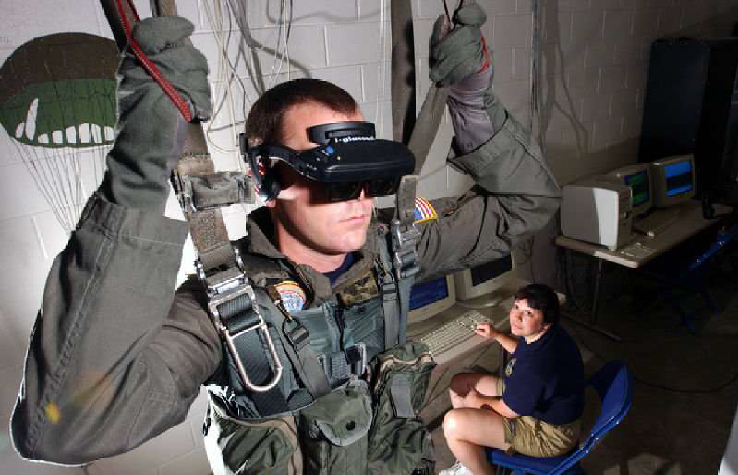
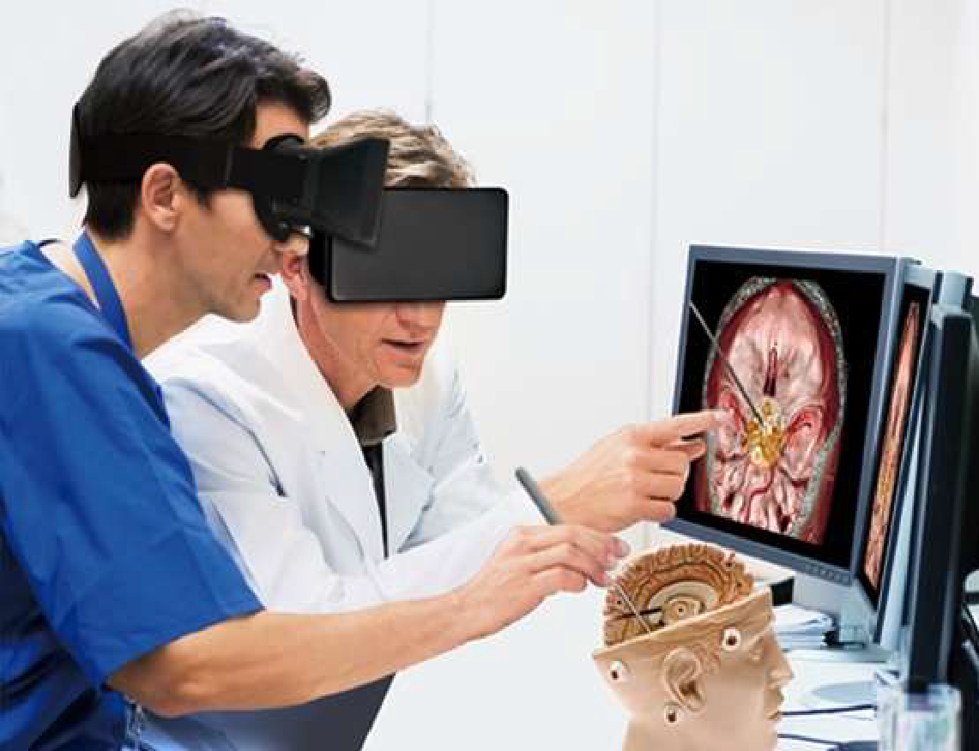
Applications of VR
VR in Military
VR in Healthcare

Slide 29
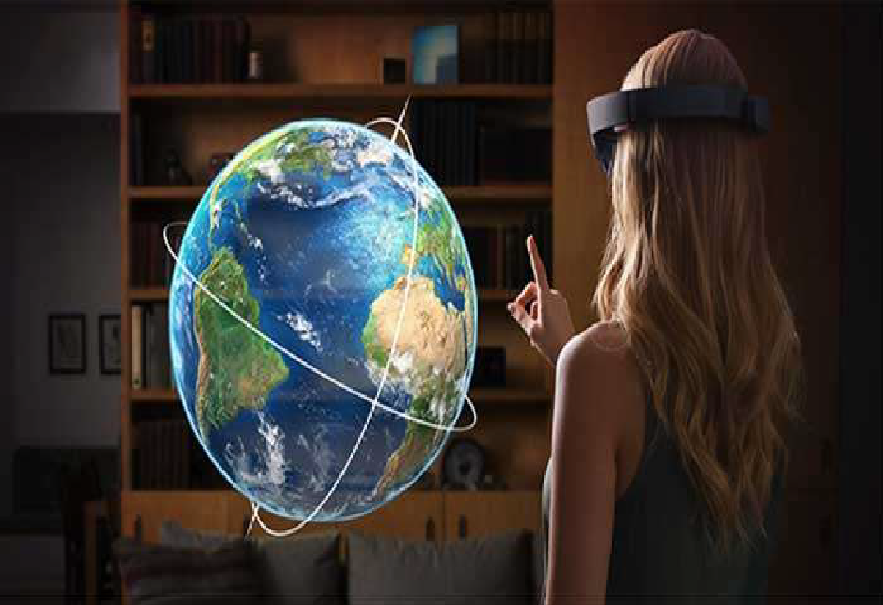
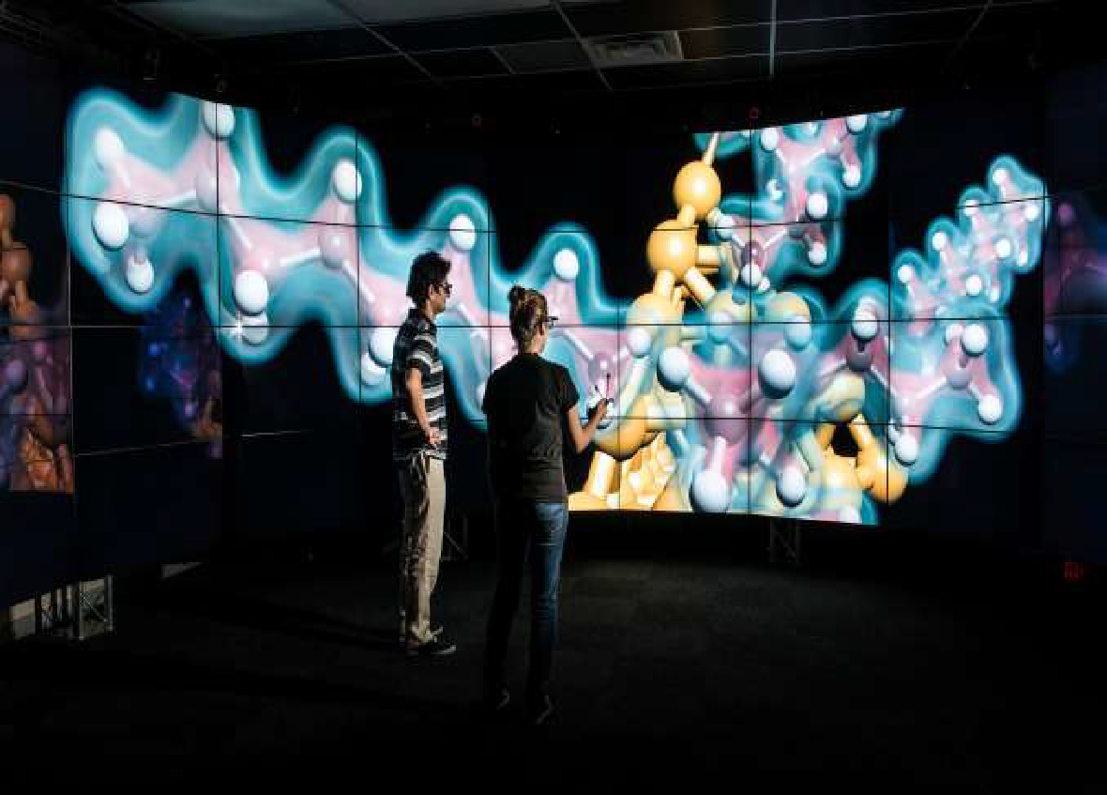
Applications of VR (cont.)
VR in Education
VR in Scientific Data Visualization

Slide 30
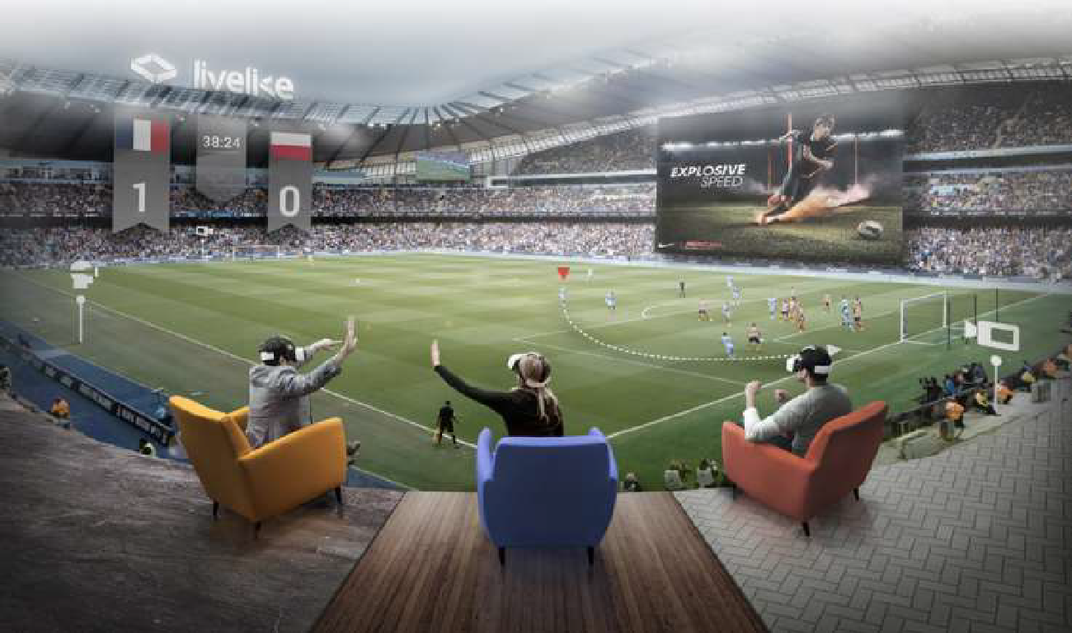
Applications of VR (cont.)
VR in Environment

Slide 31
Advantages and Disadvantages of VR
Advantages
Virtual reality creates a realistic world.
It enables user to explore places.
Through Virtual Reality user can experiment with an artificial environment.
Virtual Reality makes the education more easy and comfortable.
Disadvantages
The equipment used in virtual reality are very expensive.
It consists of complex technology.
In virtual reality environment, we can’t move by our own like in the real world.

Slide 32
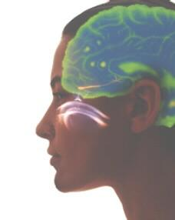
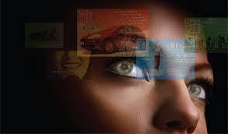
What is Augmented Reality(AR)?
https://www.youtube.com/watch?v=T5O3vijPGUw
https://www.youtube.com/watch?v=d3YT8j0yYl0
Augmented Reality:
A combination of a real scene viewed by a user and a virtual scene generated by a computer that augments the scene with additional information.
An AR system adds virtual computer-generated objects, audio and other sense enhancements to a real-world environment in real time.

Slide 33
Augmented Reality vs. Virtual reality?
Comparison of AR & VR:
Augmented reality system:
Augments the real world scene with computer generated objects
User maintains a sense of presence in real world
Needs a mechanism to combine virtual and real worlds
Virtual reality system:
Totally immersive environment
Visual senses are under control of system

Slide 34
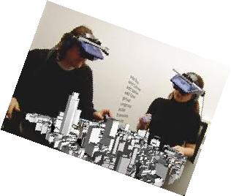
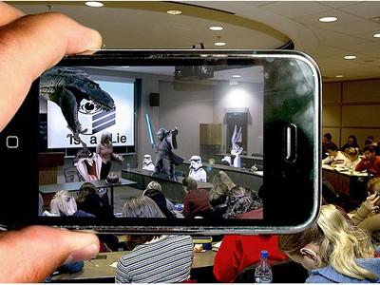
How does AR work?
Pick a real world scene.
Add your virtual objects in it.
Delete real world objects if needed.
Not virtual reality since environment real.

Slide 35
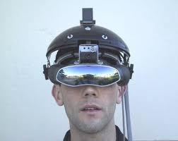
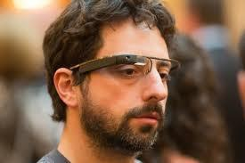
Displays used in AR
Head-mounted Display(HMD)
Device paired to a headset such as a harness or helmet
Eye Glasses
Eye wear that employs cameras to intercept the real world view and re-display it's augmented view through the eye pieces

Slide 36
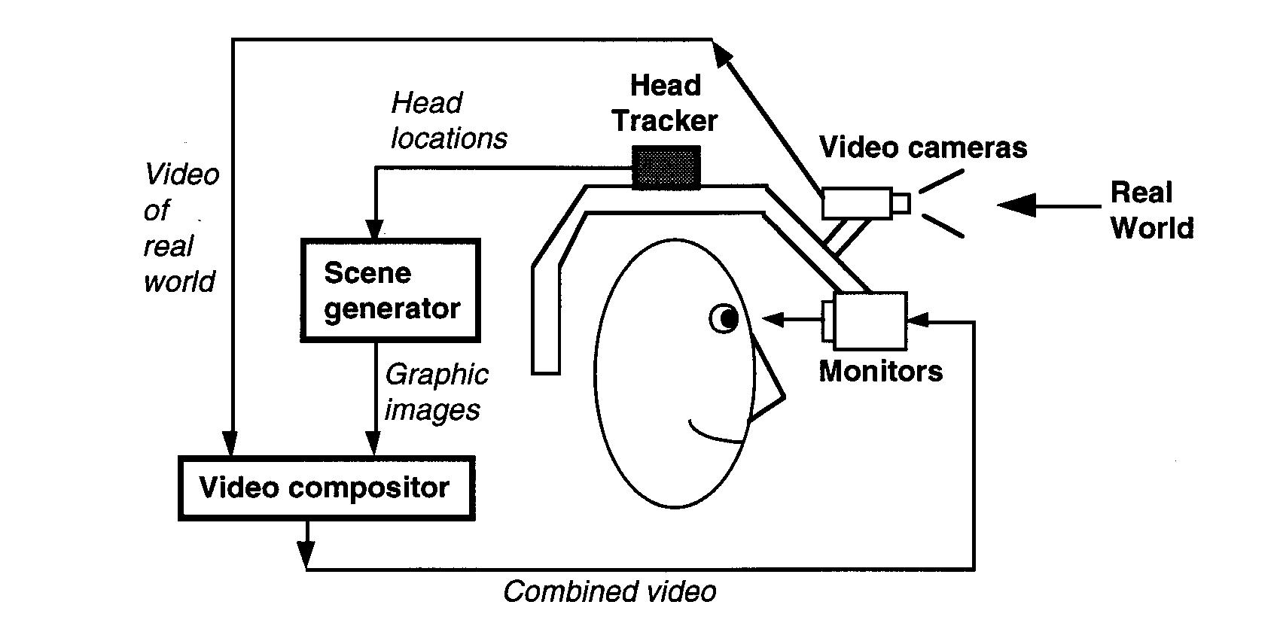
Architecture of an AR System
Video see-through HMD based AR System
Capturing of real world scene
Head tracking
Generation of graphical/artificial objects
Combining the real world scene and computer generated objects/ scene
Displaying the combined video through a head mounted display

Slide 37
Applications of AR
Medical
Entertainment
Military Training Engineering
Design
Robotics and Telerobotics
Manufacturing, Maintenance, and Repair
Consumer Design Hazard Detection Audio

Slide 38
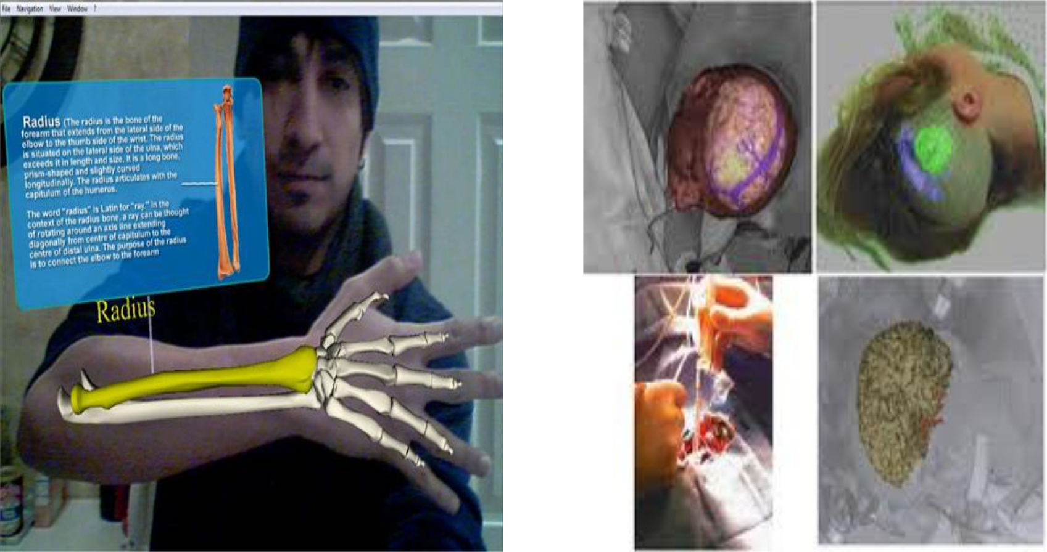
Medical Applications of AR

Slide 39
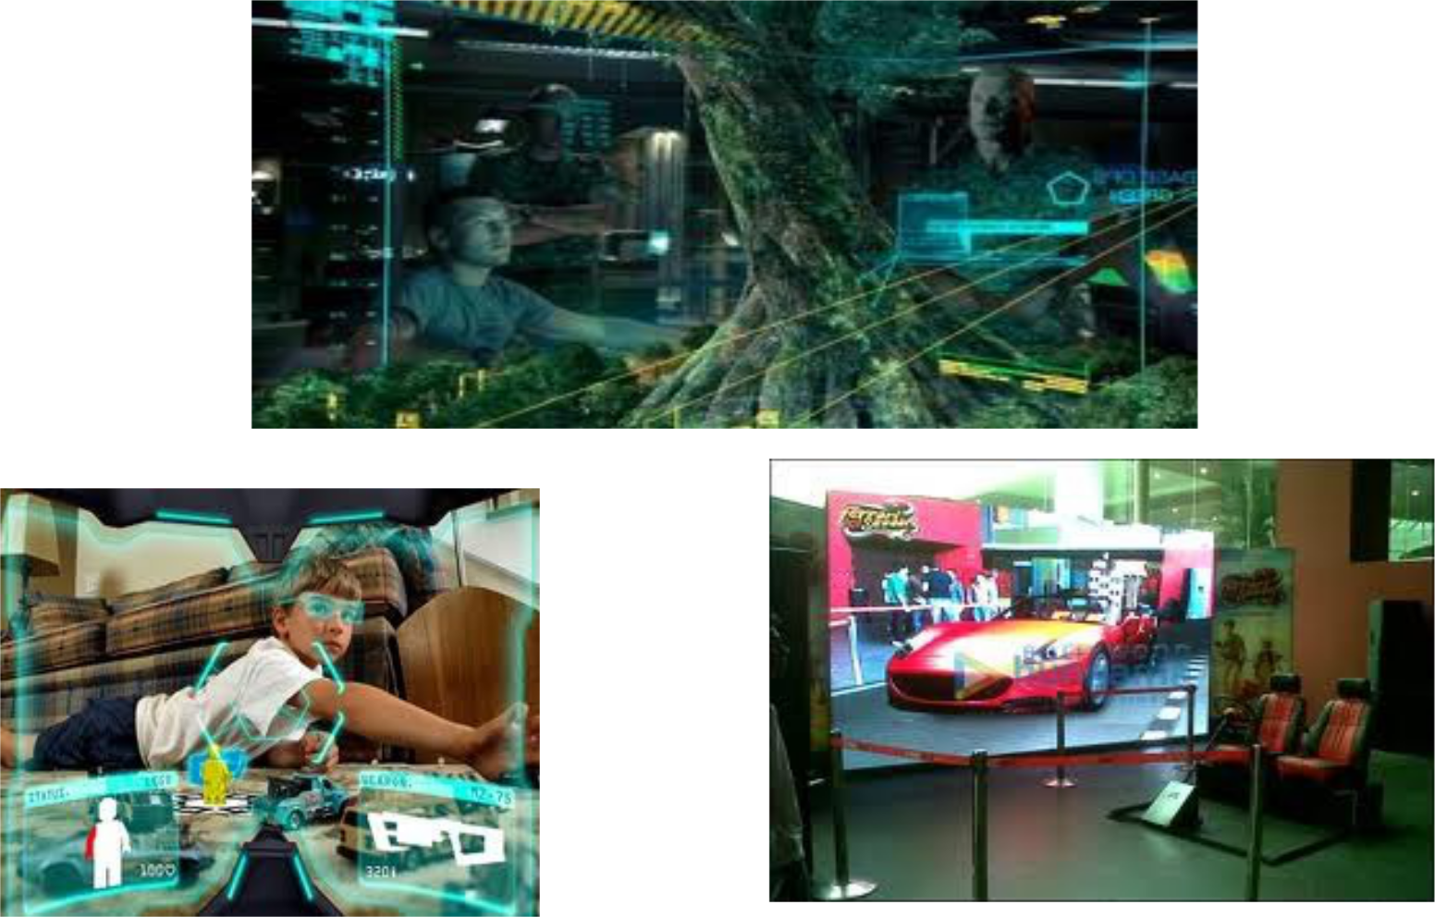
AR in Entertainment

Slide 40
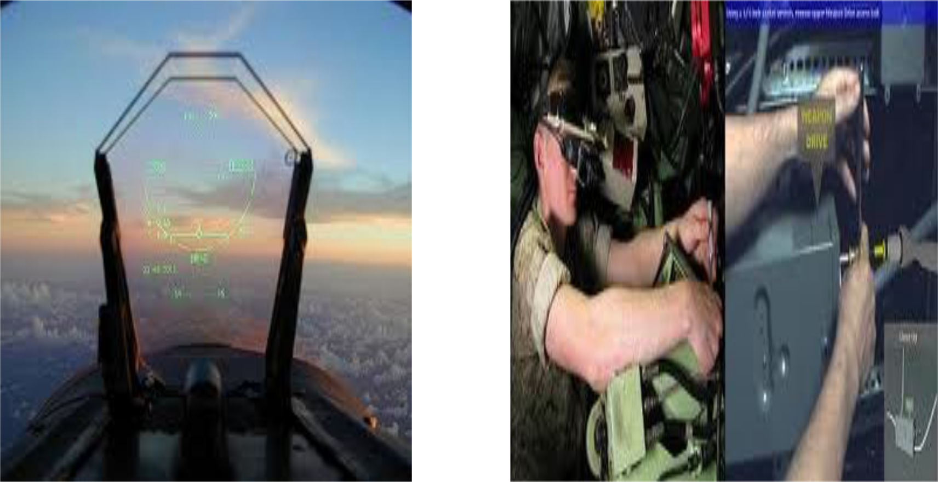
AR in Defence

